Slide 1
WELCOME
Presented By:
Presented to: Mr. Mozdaher Abdul Quader
Lecturer, Dept. of CSE Green University of Bangladesh
Name | ID
Md. Rafi Hasan | 213002250
Arafath Islam Sezan | 213902035
Shawon Reza | 213002135
Nadib Rana | 213002247

Slide 2
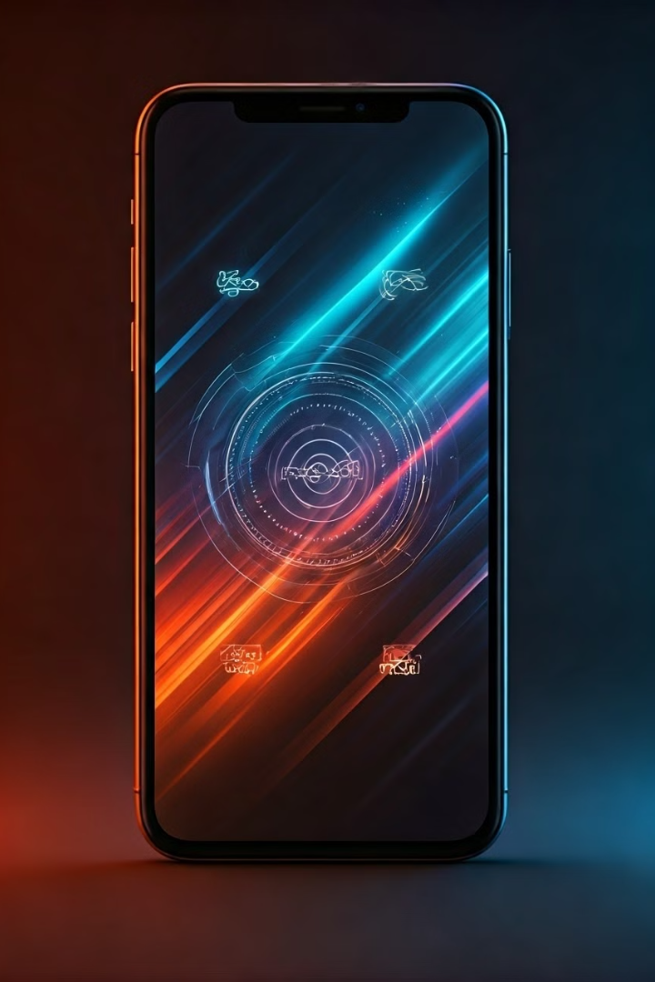
Sensors in Mobile Applications
Exploring the world of mobile sensors and their impact on user experiences

Slide 3
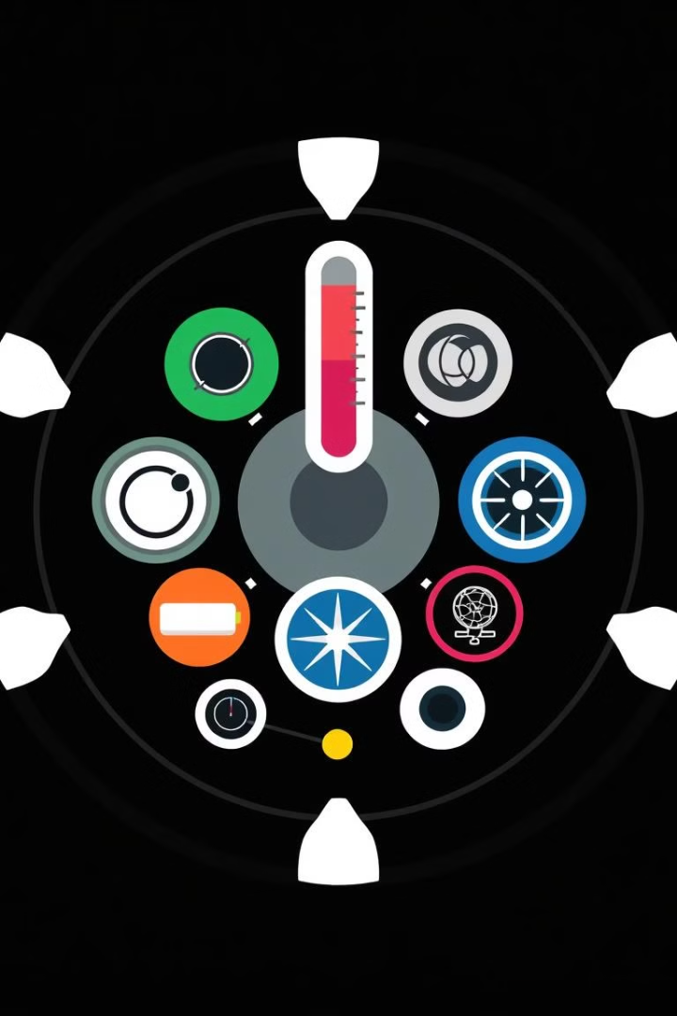

Introduction to Sensors
What are Sensors?
Sensors are devices that detect and measure physical quantities, such as temperature, light, pressure, and motion. They convert these quantities into electrical signals that can be processed by a device.

Slide 4
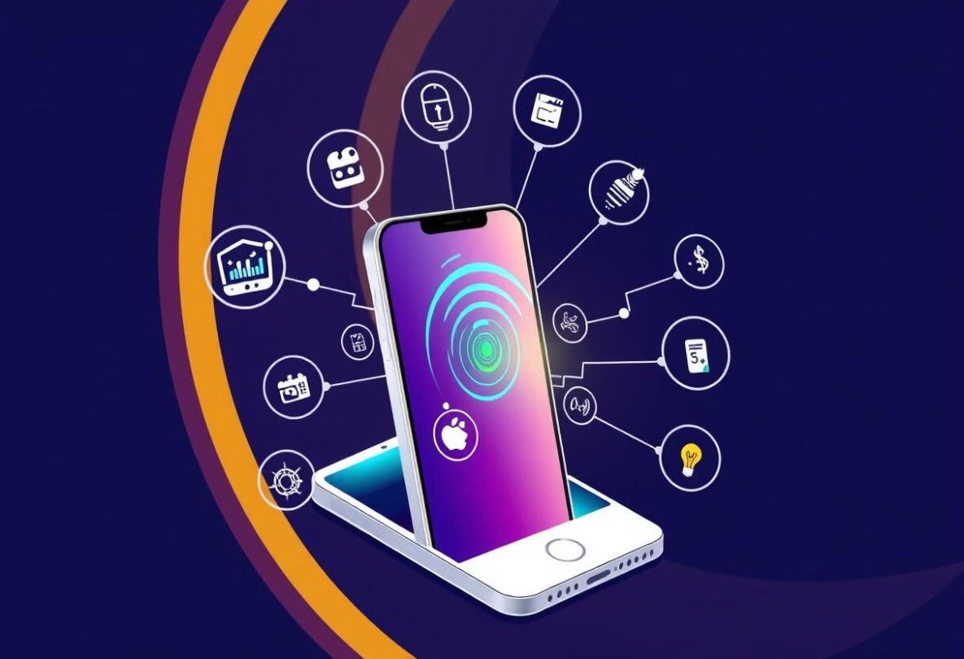
Importance of Sensors
Enhanced User Experience
Contextual Awareness
Intuitive interactions, personalized settings, and immersive experiences
Mobile devices understand their surroundings and adjust accordingly

Slide 5
Position Sensors: Tracking Location and Orientation
GPS sensor
Rotary Position Sensors:
Angular Position Sensors
Magnetometer
Detects magnetic fields, allowing for compass functionality and orientation relative to Earth's magnetic field.
Determine precise geographical location using satellite signals
Measures acceleration and tilt, determining device orientation and movement.
These measure the angle of an object relative to a reference point.

Slide 6
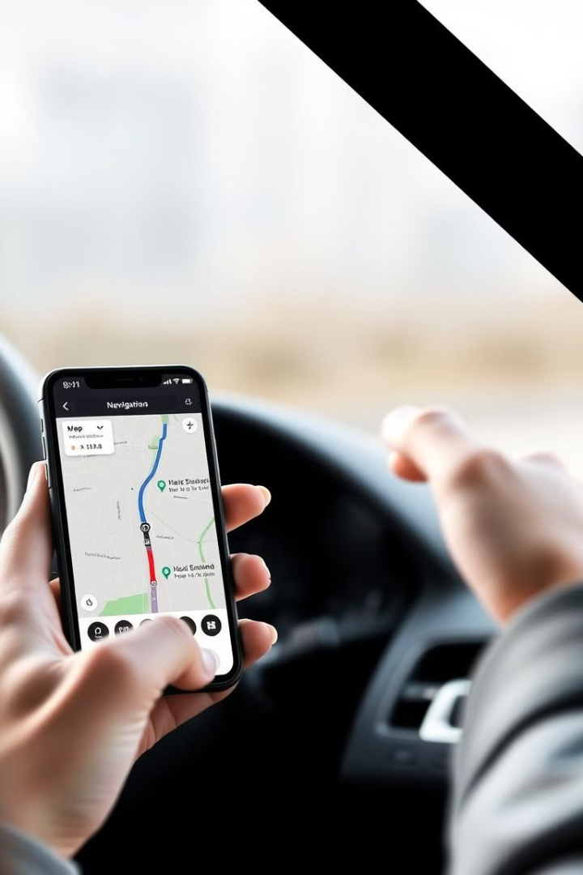
Position Sensors Examples
Navigation Apps
Augmented Reality Games
Using GPS, accelerometer, and gyroscope data, navigation apps provide turn-by-turn directions and real-time traffic updates.
AR games utilize GPS and accelerometer data to overlay virtual objects onto the real world, creating immersive experiences.
Fitness Trackers
Fitness trackers utilize GPS and accelerometer data to track distance, pace, and route during workouts.

Slide 7




Motion Sensors
Accelerometer
Gyroscope
Gravity
Measures acceleration, allowing for detecting device shake, tilt, and movement.
Measures rotation, providing information about device rotation in three dimensions. This enables gesture recognition and motion control.
Mobile devices for orientation, motion tracking, and gaming applications.

Slide 8
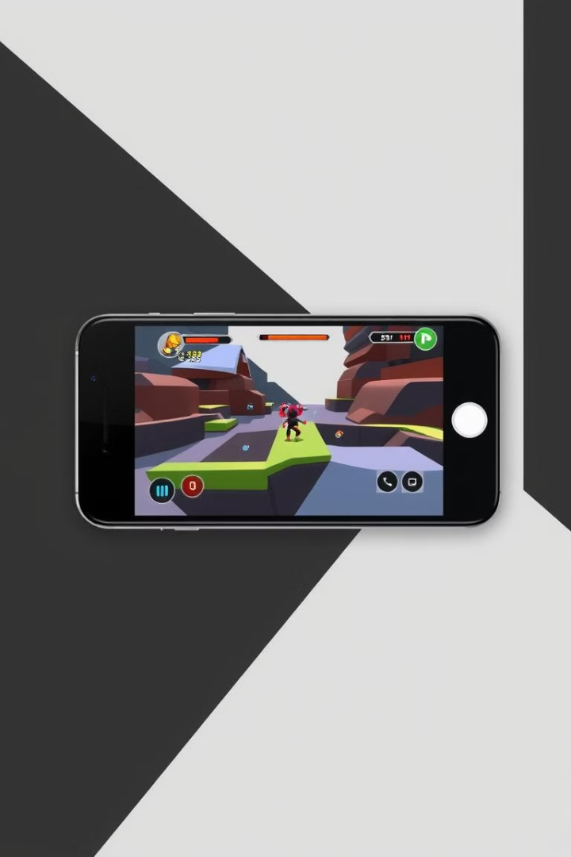



Motion Sensors Examples
Gaming
Motion sensors enable intuitive gameplay controls, such as tilting the device to steer a car or using gestures to control characters.
Gesture Recognition
Apps can detect gestures, like swiping or shaking, for navigating menus, controlling music playback, and taking photos.
Virtual Reality
VR experiences utilize motion sensors to track head movement, providing immersive 360-degree views.

Slide 9
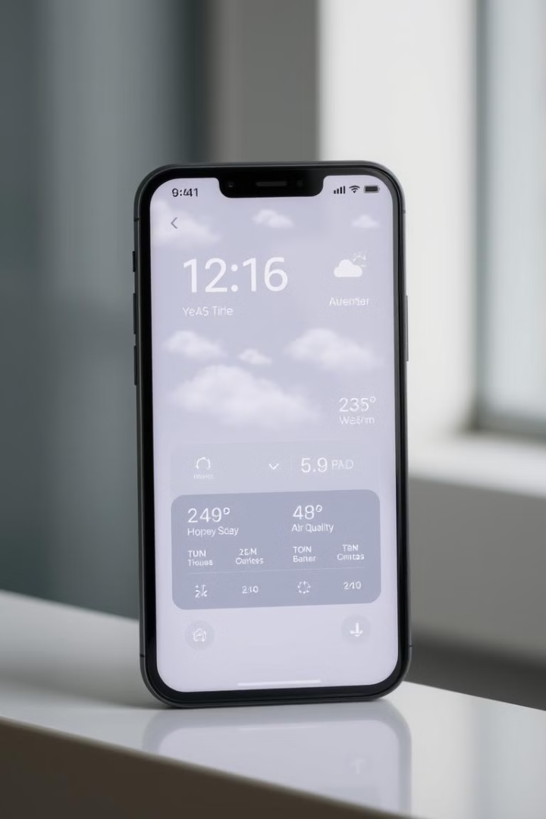
Environmental Sensors: Monitoring Surroundings
1
Light Sensor
Detects ambient light levels, adjusting screen brightness for optimal visibility.
2
Barometer
Measures atmospheric pressure, providing information about altitude and weather changes.
3
Temperature Sensor
Measures device temperature, useful for monitoring overheating and battery health.
4
Humidity Sensor
Detects moisture levels in the air, useful for weather apps and smart home automation.

Slide 10




Environmental Sensors Examples
1
Smart Home Control
Weather Apps
2
Use environmental sensors to provide accurate and real-time weather forecasts and conditions.
Fitness Trackers
3
Monitor altitude and temperature during outdoor workouts.
Smart Home Automation
4
Use light sensors to automatically adjust lighting levels in a home.

Slide 11
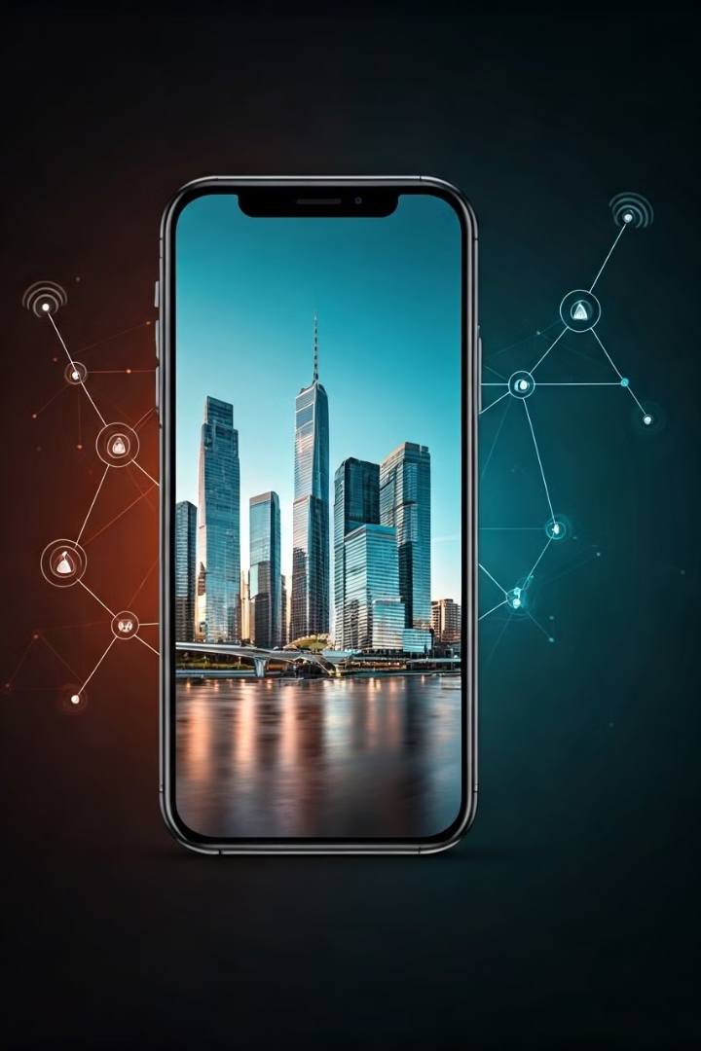



Sensor Integration for Enhanced User Experience
Location Services
Maps, navigation, and location-based services
Health and Fitness
Step counting, heart rate monitoring, and sleep tracking
Camera
Autofocus, image stabilization, and augmented reality

Slide 12
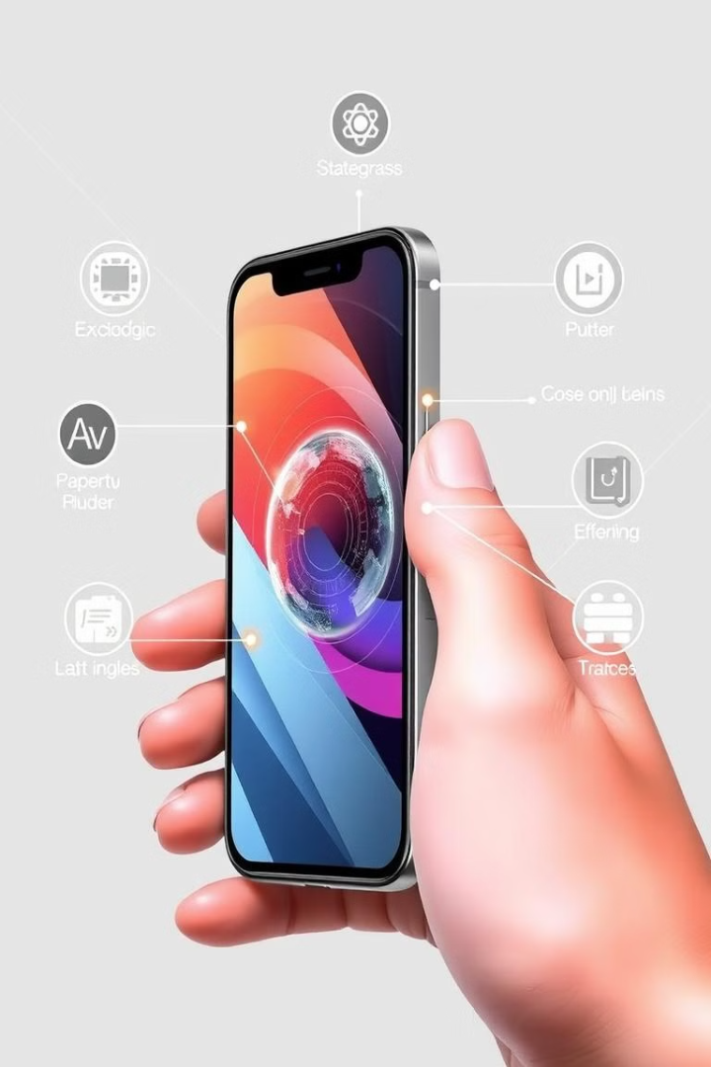
Conclusion
Sensors are integral to modern Android devices, enhancing user experiences and unlocking new possibilities. They enable a wide range of applications, from navigation and gaming to fitness tracking and smart home control. By leveraging sensor data, developers and users can create innovative and immersive experiences.

Slide 13
Thank You!
We appreciate your time and attention.

Slide 14
Questions & Answers
We are now happy to answer any questions you may have.

